Slide 1
Context-Free Languages

Slide 2

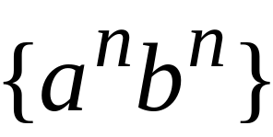
Context-Free Languages
Regular Languages
Courtesy Costas Busch - RPI

Slide 3
Context-Free Languages
Context-Free
Grammars
Pushdown
Automata
stack
automaton
Courtesy Costas Busch - RPI

Slide 4
Context-Free Grammars
Courtesy Costas Busch - RPI

Slide 5
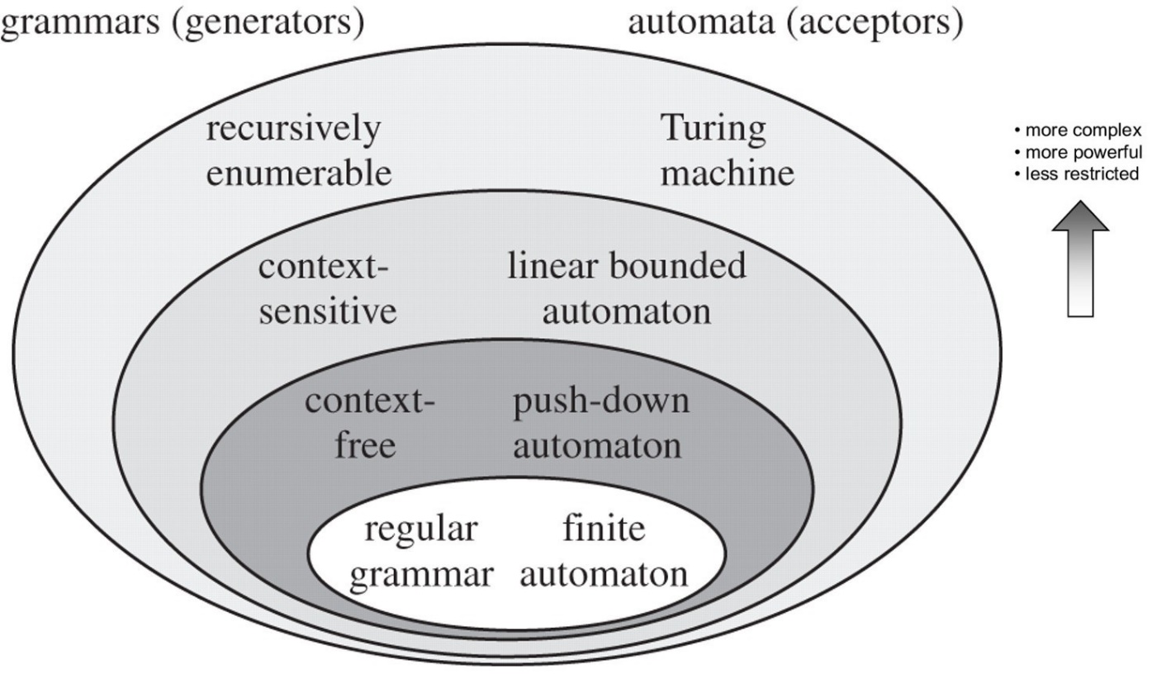
Courtesy Costas Busch - RPI

Slide 6


Example
A context-free grammar :
One non terminal → terminal/non terminal
A derivation:
Courtesy Costas Busch - RPI

Slide 7
A context-free grammar :
Another derivation:
Courtesy Costas Busch - RPI

Slide 8


Courtesy Costas Busch - RPI

Slide 9
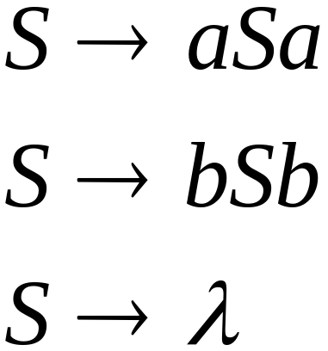
Example
A context-free grammar :
A derivation:
Courtesy Costas Busch - RPI

Slide 10
A context-free grammar :
Another derivation:
Courtesy Costas Busch - RPI

Slide 11
Courtesy Costas Busch - RPI

Slide 12

Courtesy Costas Busch - RPI

Slide 13
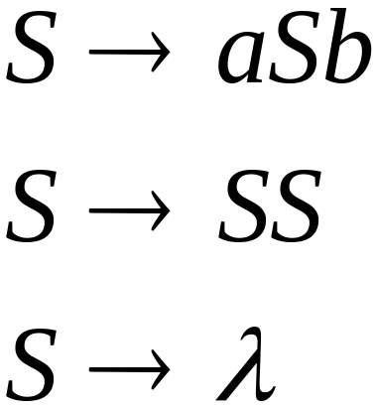
Example
A context-free grammar :
A derivation:
Courtesy Costas Busch - RPI

Slide 14
A context-free grammar :
A derivation:
Courtesy Costas Busch - RPI

Slide 15
Courtesy Costas Busch - RPI

Slide 16
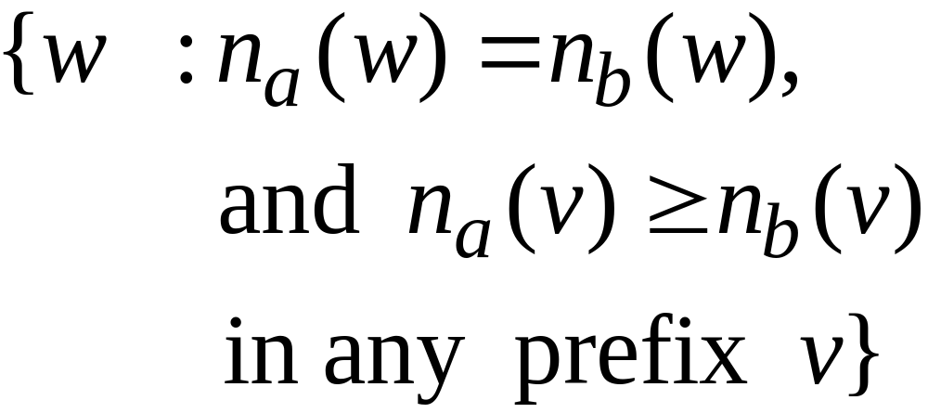
Courtesy Costas Busch - RPI

Slide 17

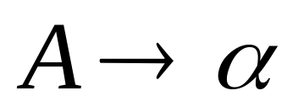

Definition: Context-Free Grammars
Grammar
Variables
Terminal
symbols
Start
variables
Productions of the form:
is string of variables and terminals
Courtesy Costas Busch - RPI

Slide 18
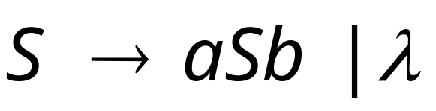




Example of Context-Free Grammar
productions
start variable
variables
terminals
Courtesy Costas Busch - RPI

Slide 19
Notation: Context-Free Grammars
Lower case letters near beginning of alphabet
(e.g. a, b, c, …) are terminal symbols
Upper case letters near beginning of alphabet
(e.g. A, B, C, …) are variables
Lower case letters near end of alphabet
(e.g. w, x, …) are strings of terminals
Upper case letters near end of alphabet
(e.g. X, Y, …) are either terminals or strings
Lower case Greek letters
(e.g. α, β, γ, …) are strings of terminals and/or variables
Courtesy Costas Busch - RPI

Slide 20

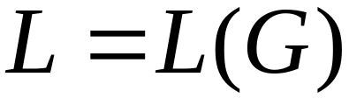
Definition: Context-Free Languages
A language is context-free
if and only if
there is a grammar with
Courtesy Costas Busch - RPI

Slide 21


Recall
Language of a Grammar
For a grammar
with start variable :
String of terminals
Courtesy Costas Busch - RPI

Slide 22
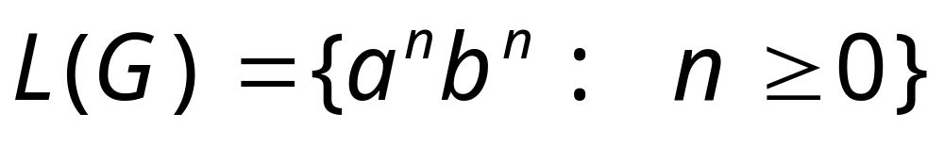
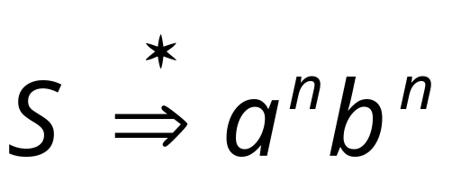
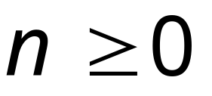
Example:
context-free grammar :
Since, there is derivation
for any
Courtesy Costas Busch - RPI

Slide 23
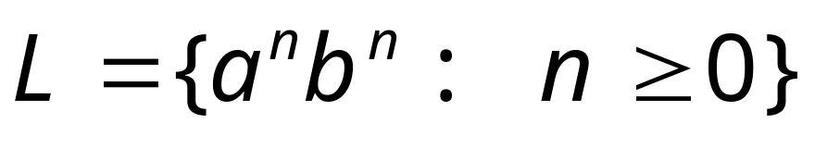
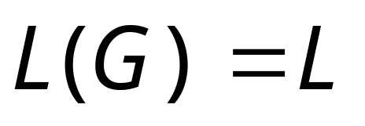
Example:
is a context-free language
since context-free grammar :
generates
Courtesy Costas Busch - RPI

Slide 24
Derivation Order and
Derivation Trees

Slide 25
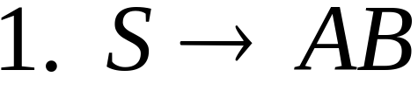
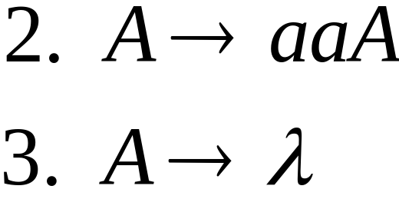
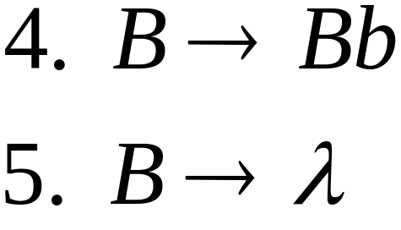
Derivation Order
Consider the following example grammar
with 5 productions:
Derive a string aab
Courtesy Costas Busch - RPI

Slide 26
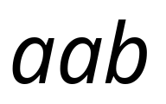

Leftmost derivation order of string :
At each step, we substitute the
leftmost variable
Courtesy Costas Busch - RPI

Slide 27

Rightmost derivation order of string :
At each step, we substitute the
rightmost variable
Courtesy Costas Busch - RPI

Slide 28
Leftmost derivation of :
Rightmost derivation of :
Courtesy Costas Busch - RPI

Slide 29
Derivation Trees

Slide 30

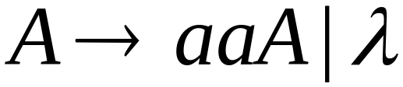
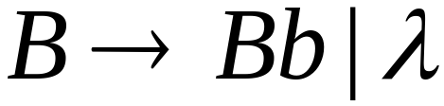




Courtesy Costas Busch - RPI

Slide 31


Courtesy Costas Busch - RPI

Slide 32

Courtesy Costas Busch - RPI

Slide 33

Courtesy Costas Busch - RPI

Slide 34
Derivation Tree
Courtesy Costas Busch - RPI

Slide 35
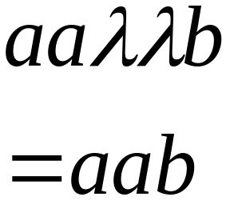
Derivation Tree
yield
Courtesy Costas Busch - RPI

Slide 36
Partial Derivation Trees
Partial derivation tree
Courtesy Costas Busch - RPI

Slide 37
Partial derivation tree
Courtesy Costas Busch - RPI

Slide 38

sentential
form
Partial derivation tree
yield
Courtesy Costas Busch - RPI

Slide 39
Sometimes, derivation order doesn’t matter
Leftmost:
Rightmost:
Same derivation tree
Courtesy Costas Busch - RPI

Slide 40
Ambiguity
Courtesy Costas Busch - RPI

Slide 41
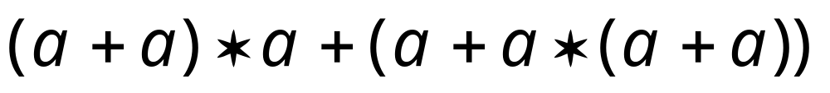
Grammar for mathematical expressions
Example strings:
Denotes any number
Courtesy Costas Busch - RPI

Slide 42





A leftmost derivation
for
Courtesy Costas Busch - RPI

Slide 43

Another
leftmost derivation
for
Courtesy Costas Busch - RPI

Slide 44
Two derivation trees
for
Courtesy Costas Busch - RPI

Slide 45
The grammar
is ambiguous:
string
has two derivation trees
Courtesy Costas Busch - RPI

Slide 46
The grammar
is ambiguous:
string
has two leftmost derivations
Courtesy Costas Busch - RPI

Slide 47

Definition:
A context-free grammar is ambiguous
if some string has:
two or more derivation trees
Courtesy Costas Busch - RPI

Slide 48
In other words:
A context-free grammar is ambiguous
if some string has:
two or more leftmost derivations
(or rightmost)
Courtesy Costas Busch - RPI

Slide 49

Why do we care about ambiguity?
take
Courtesy Costas Busch - RPI

Slide 50


Courtesy Costas Busch - RPI

Slide 51





Courtesy Costas Busch - RPI

Slide 52
Correct result:
Courtesy Costas Busch - RPI

Slide 53
Ambiguity is bad for programming languages
We want to remove ambiguity
Courtesy Costas Busch - RPI

Slide 54
Ambiguous Grammar:
A context-free grammar is ambiguous
if there is a string which has:
two different derivation trees
or
two leftmost derivations
(Two different derivation trees give two
different leftmost derivations and vice-versa)
Courtesy Costas Busch - RPI

Slide 55

Another ambiguous grammar:
IF_STMT
if EXPR then STMT
if EXPR then STMT else IF_STMT
Variables
Terminals
Very common piece of grammar
in programming languages
Courtesy Costas Busch - RPI

Slide 56
If expr1 then if expr2 then stmt1 else stmt2
IF_STMT
if
expr1
then
STMT
if
expr2
then
stmt1
else
stmt2
Two derivation trees
IF_STMT
if
expr1
then
STMT
else
stmt2
if
expr2
then
stmt1
Courtesy Costas Busch - RPI

Slide 57
In general, ambiguity is bad
and we want to remove it
Sometimes it is possible to find
a non-ambiguous grammar for a language
But, in general ιt is difficult to achieve this
Courtesy Costas Busch - RPI

Slide 58
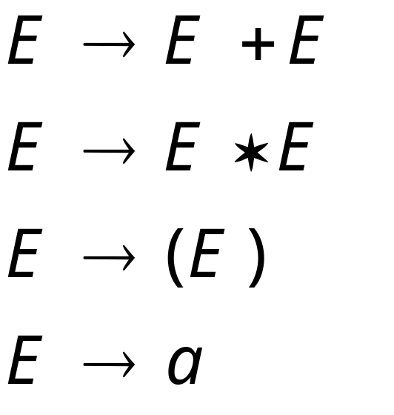
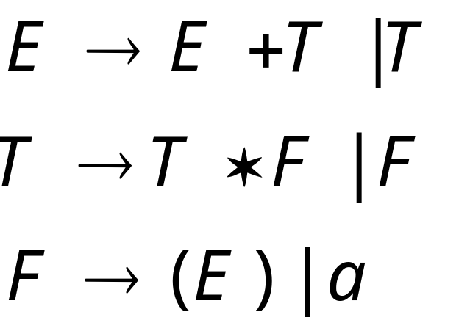
A successful example:
Equivalent
Ambiguous
Grammar
Non-Ambiguous
Grammar
generates the same
language
Courtesy Costas Busch - RPI

Slide 59

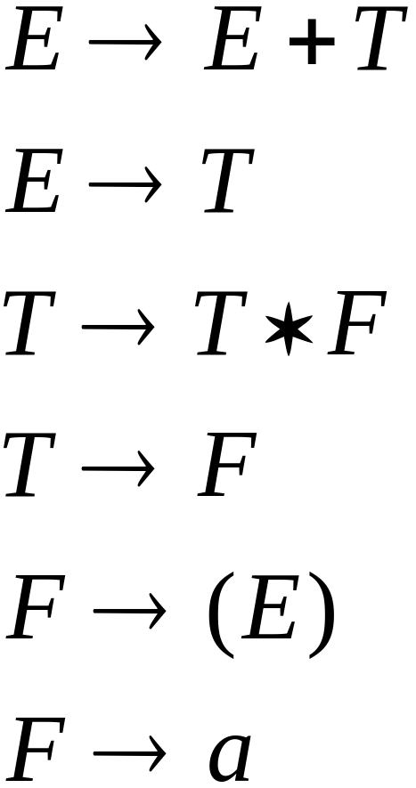


Courtesy Costas Busch - RPI

Slide 60
Unique derivation tree
Courtesy Costas Busch - RPI

Slide 61
The grammar :
is non-ambiguous:
Every string has
a unique derivation tree
Courtesy Costas Busch - RPI

Slide 62
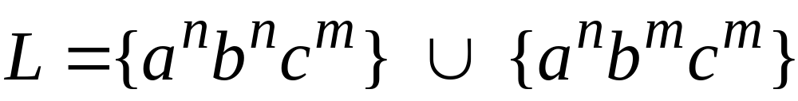

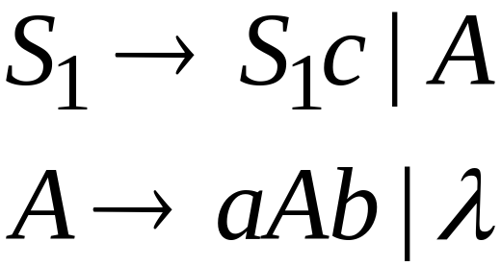
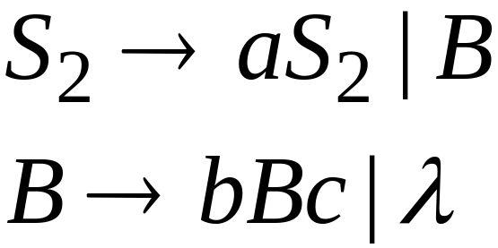
Inherent Ambiguity
Some context free languages
have only ambiguous grammars
Example:
Courtesy Costas Busch - RPI

Slide 63


An un-successful example:
is inherently ambiguous:
every grammar that generates this
language is ambiguous
Courtesy Costas Busch - RPI

Slide 64
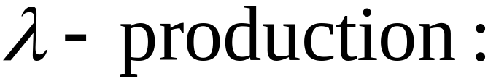


Nullable Variables
Nullable Variable:
Courtesy Costas Buch - RPI

Slide 65

Example (ambiguous) grammar for :
Courtesy Costas Busch - RPI

Slide 66
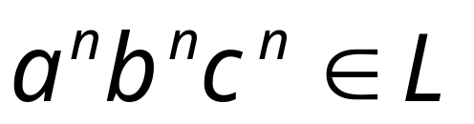



The string
has always two different derivation trees
(for any grammar)
For example
Courtesy Costas Busch - RPI

Slide 67
Simplifications of
Context-Free Grammars

Slide 68
Removing All
Step 1: Remove Nullable Variables
Step 2: Remove Unit-Productions
Step 3: Remove Useless Variables
Courtesy Costas Buch - RPI

Slide 69
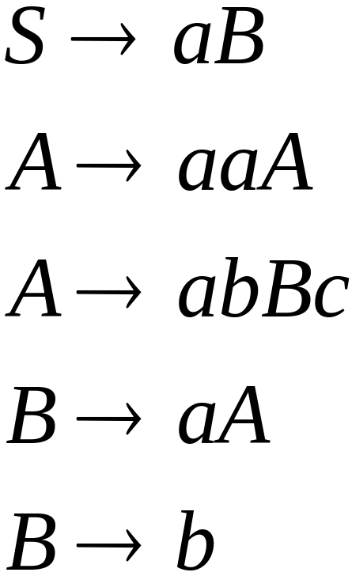
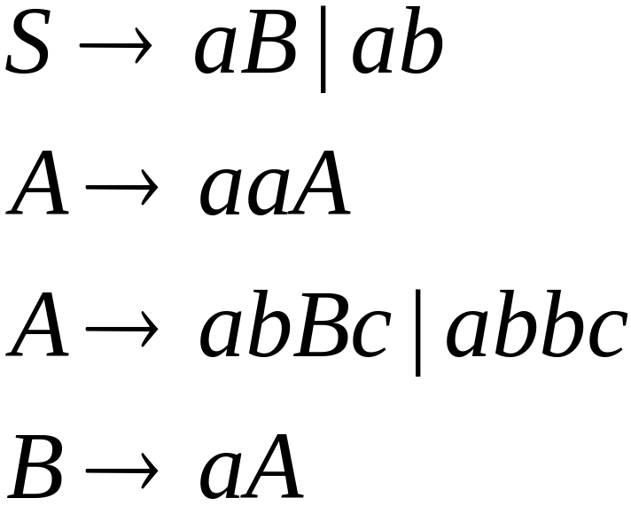

A Substitution Rule
Equivalent
grammar
Substitute
Courtesy Costas Buch - RPI

Slide 70


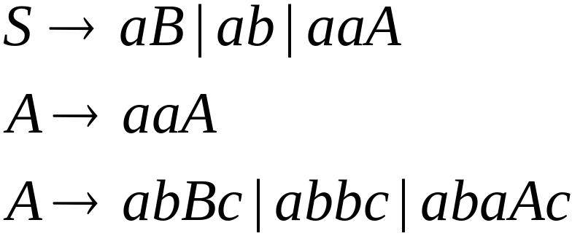
A Substitution Rule
Substitute
Equivalent
grammar
Courtesy Costas Buch - RPI

Slide 71
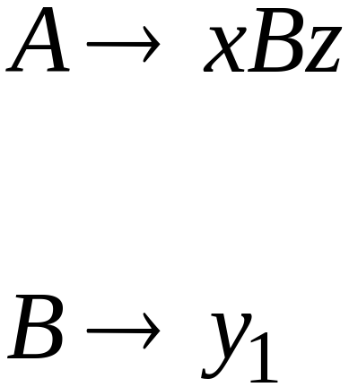
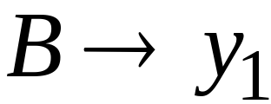
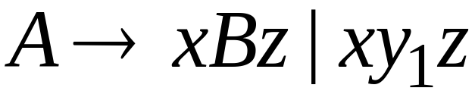
In general:
Substitute
equivalent
grammar
Courtesy Costas Buch - RPI

Slide 72
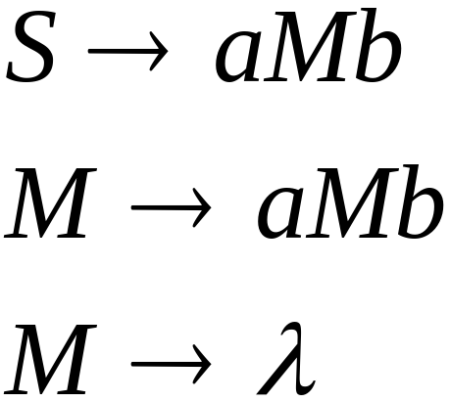
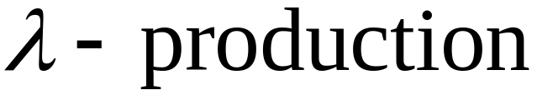
Removing Nullable Variables
Example Grammar:
Nullable variable
Courtesy Costas Buch - RPI

Slide 73
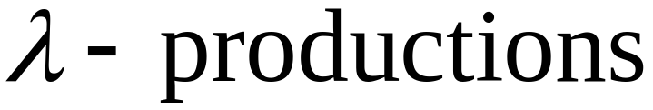
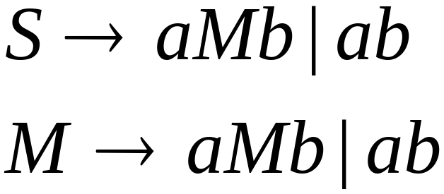

Removing
Substitute
After we remove all the
all the nullable variables disappear
(except for the start variable)
Courtesy Costas Buch - RPI

Slide 74

Unit-Productions
Unit Production:
(a single variable in both sides)
Courtesy Costas Buch - RPI

Slide 75

Removing Unit Productions
Observation:
Is removed immediately
Courtesy Costas Buch - RPI

Slide 76
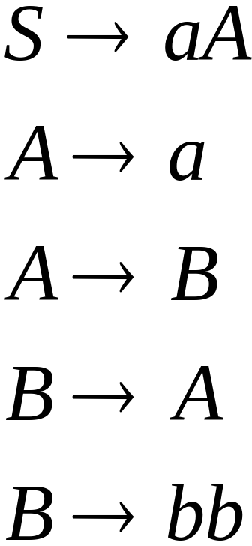
Example Grammar:
Courtesy Costas Buch - RPI

Slide 77
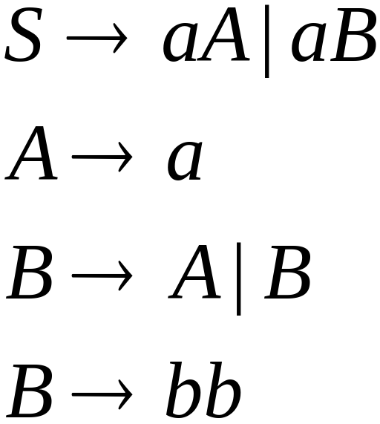

Substitute
Courtesy Costas Buch - RPI

Slide 78
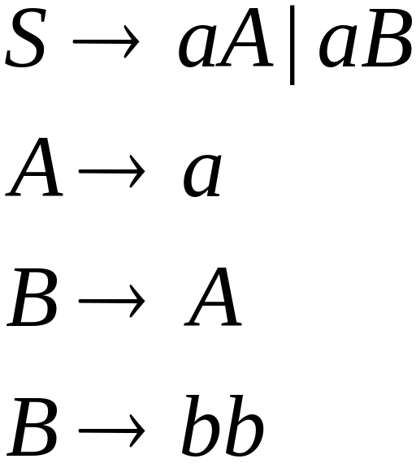

Remove
Courtesy Costas Buch - RPI

Slide 79
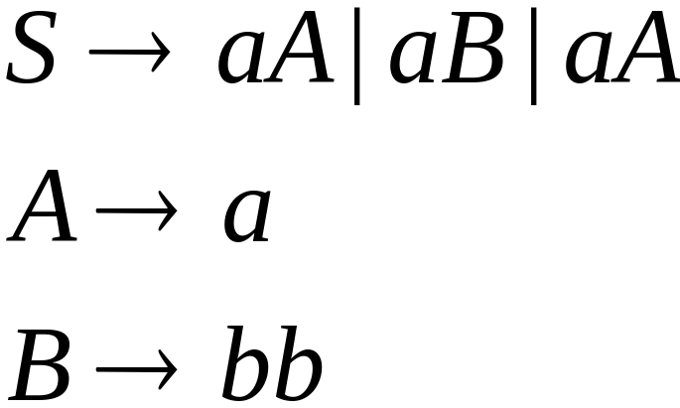

Substitute
Courtesy Costas Buch - RPI

Slide 80
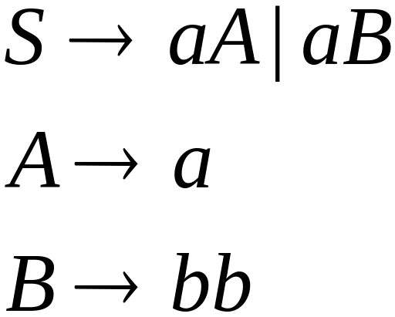
Remove repeated productions
Final grammar
Courtesy Costas Buch - RPI

Slide 81
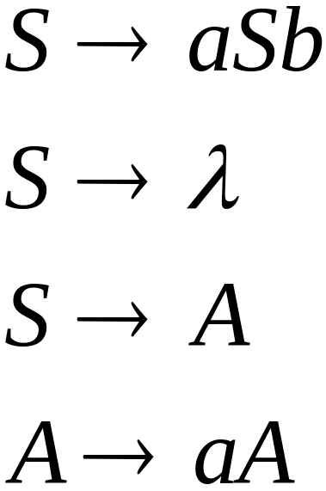
Useless Productions
Useless Production
Some derivations never terminate...
Courtesy Costas Buch - RPI

Slide 82
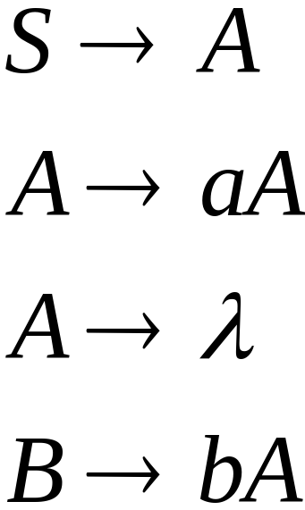
Another grammar:
Useless Production
Not reachable from S
Courtesy Costas Buch - RPI

Slide 83


In general:
contains only
terminals
if
then variable is useful
otherwise, variable is useless
Courtesy Costas Buch - RPI

Slide 84

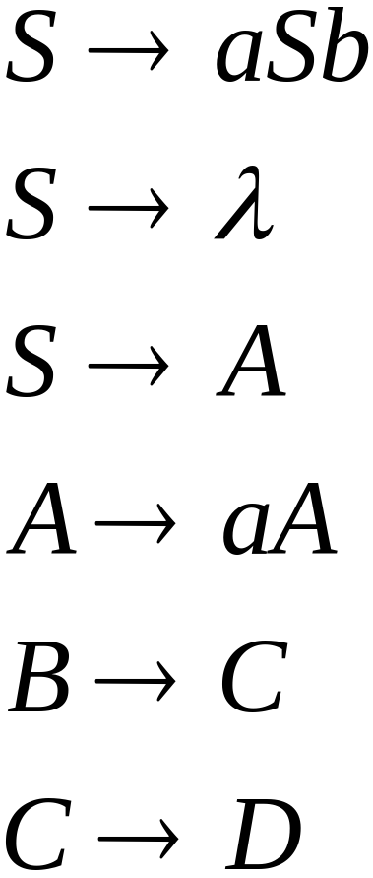
A production is useless
if any of its variables is useless
Productions
Variables
useless
useless
useless
useless
useless
useless
useless
Courtesy Costas Buch - RPI

Slide 85
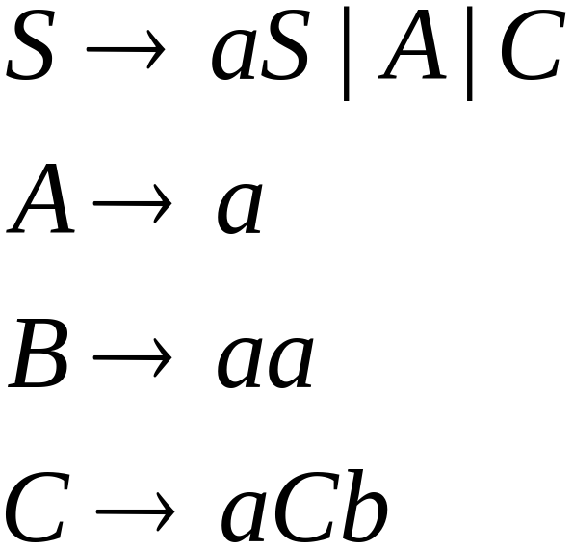
Removing Useless Productions
Example Grammar:
Courtesy Costas Buch - RPI

Slide 86
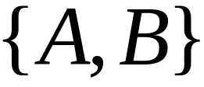

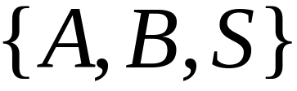
First:
find all variables that can produce
strings with only terminals
Round 1:
Round 2:
Courtesy Costas Buch - RPI

Slide 87

Keep only the variables
that use variables :
(the rest variables are useless)
Remove useless productions
Courtesy Costas Buch - RPI

Slide 88
Second:
Find all variables
reachable from
Use a Dependency Graph
unreachable
Note: nodes are variables
Courtesy Costas Buch - RPI

Slide 89

Keep only the variables
reachable from S
(the rest variables are useless)
Final Grammar
Remove useless productions
Courtesy Costas Buch - RPI

Slide 90
Normal Forms for
Context-free Grammars
Courtesy Costas Buch - RPI

Slide 91


Chomsky Normal Form
Each productions has form:
Nonterminal → string of only two Nonterminals
Nonterminal → one terminal
or
variable
variable
terminal
Courtesy Costas Buch - RPI

Slide 92

CNF STEPS
Courtesy Costas Busch - RPI

Slide 93

Example
S→ ASA| aB
A→ B| S
B → b |λ
Not in CNF, because it not follow the rules of CNF
Courtesy Costas Busch - RPI

Slide 94

S→ ASA| aB
A→ B| S
B → b |λ
Courtesy Costas Busch - RPI

Slide 95


Step # 2 Remove Null Productions
Removing B→ λ
Courtesy Costas Busch - RPI

Slide 96


Step # 2 Remove Null Productions
Removing A→ λ
Courtesy Costas Busch - RPI

Slide 97


Step # 3 Remove Unit Productions
Remove S → S
Courtesy Costas Busch - RPI

Slide 98


Step # 3 Remove Unit Productions
Courtesy Costas Busch - RPI

Slide 99


Step # 3 Remove Unit Productions
Remove A→ B
Courtesy Costas Busch - RPI

Slide 100


Step # 3 Remove Unit Productions
Remove A→ S
Courtesy Costas Busch - RPI

Slide 101


Step # 4 Remove More than two variables on RHS
Courtesy Costas Busch - RPI

Slide 102


Step # 5
Courtesy Costas Busch - RPI

Slide 103


Example # 2
Step 1: We will create a new production
S1 → S, as the start symbol S appears on
the RHS.
Courtesy Costas Busch - RPI

Slide 104

Step 2: As grammar G1 contains A → ε null production, its removal from the grammar yields:
Courtesy Costas Busch - RPI

Slide 105

Now, as grammar G1 contains Unit production S → B, its removal yield:
Courtesy Costas Busch - RPI

Slide 106

Also remove the unit production S1 → S, its removal from the grammar yields:
Courtesy Costas Busch - RPI

Slide 107

Step 3: In the production rule S0 → aA | Aa, S → aA | Aa, A → aBB and B → Aa, terminal a exists on RHS with non-terminals. So we will replace terminal a with X:
Courtesy Costas Busch - RPI

Slide 108


Step 4: In the production rule A → XBB, RHS has more than two symbols, removing it from grammar yield:
Courtesy Costas Busch - RPI

